Slide 1

DILI Category Prediction
ALY6020 Predictive Analytics
Submitted by: Sumit Kashyap
Abhay Verma
Mohit Abbie

Slide 2
What is the Problem?
Before a drug getting into the market it goes through rigorous testing by FDA but the testing process takes time, money and a lot of lives(IN-VIVO testing) ;(The FDA's Drug Review Process: Ensuring Drugs Are Safe and Effective, n.d.).
Every drug go though 100’s of test before it is been identified but It has also been observed that even after the drug approval, some drugs had been taken out of the market due to its toxicity being discovered once its in the market. Not surprisingly, drugs with results that look promising in cell cultures or in animal testing can fail in human testing.
There is no faster method available in Market to identify those drugs before this situation’s seriousness may arise.
Example: Darvon & Darvocet stayed in the market for 50 years after being taken off from the market, killing 2,110 people in between 1981 and 1999 (2014). There is a big list of drugs like that.

Slide 3
Why this research?
Though out all those years, (Toxcast) stored information about assays representing more than 1100 endpoint, covering 200 high level cell responses. Toxcast data is an US Environmental Protection Agency initiative that runs automated chemical screening technologies to expose.
With this research we wanted to utilize that data and build a predictive model that can potential identify potential harmful drugs and also to find the test that are good predictor so that we can reduce the cost, time and lives that FDA as well as pharma companies have to put in identifying the toxicity.

Slide 4
PROJECT GOAL
Build Predictive model for the EBTC data to identify DILI Category based on Toxcast in vitro assay results.
Identify the important features that could accurately predict the category of drugs.

Slide 5
Data Description
Attributes | Details | Type of Variable
chnm | Chemical Name | Information for Understanding
Classification | DILI Catogeries ( MostDILI , Others ( NoDILI + LessDILI) | Dependent Variable
EC50 | EC50 Values for different asseys | Independent Variable
Cratio | Normalization standard for Human exposure, Cratio = EC50/Cmax | Dependent Variable
Cmax | Peak drug concentration on test area | Independent Variable
test | Test Performance | Independent Variable
test_target | Scientific process of screening Assay target | Independent Variable
We have utilized Toxcast data set to obtain necessary information to build a predictive model
We have also utilized Data from past research i.e medNas_dili_tt, data generated by xs team: AC50_DILI

Slide 6
STEPS INVOLVED IN PROCESS
Data Cleaning
Data Modeling for Prediction
Predictive Modeling
Cross Validating Model
Summarizing Results

Slide 7
Data Cleaning
MedNas_dili_tt & AC50 Matrix data (Dataset 1) :
Obtained Distinct number of chemicals with there Cmax, classification, casn, test_target
Extracted NAS values from AC50 Matrix data
Applied on-hot encoding
Xs Teams Dataset (Dataset 2) :
Extracted important columns
Add Important variable like Cmax values
Further cleaned the data and removed and duplicate values

Slide 8
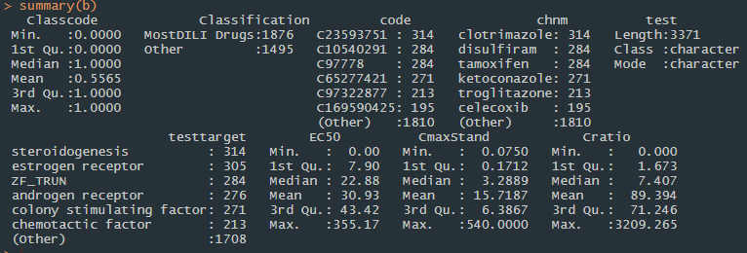
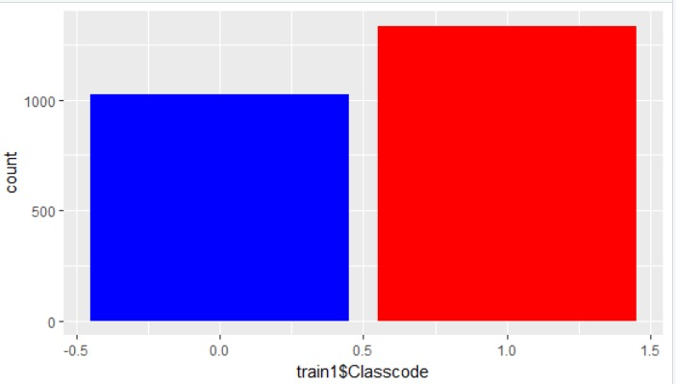
EDA

Slide 9
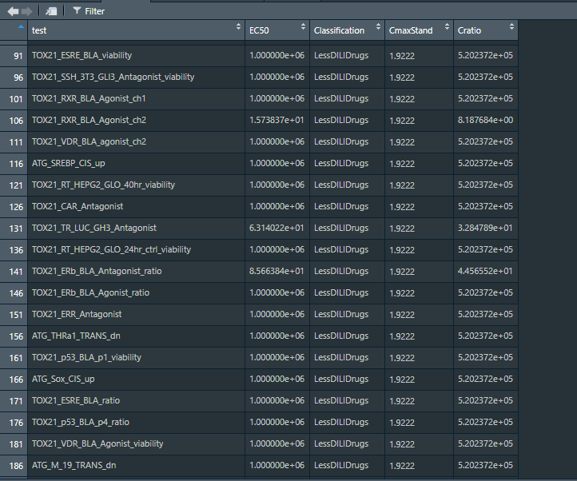
Final Dataset
Removed description information
like chemical name and code as
it doesn’t help in modeling.

Slide 10
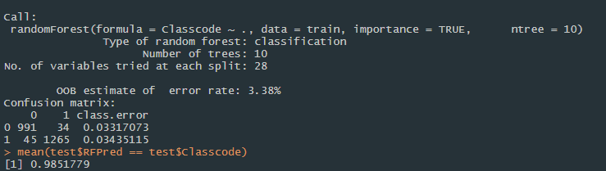
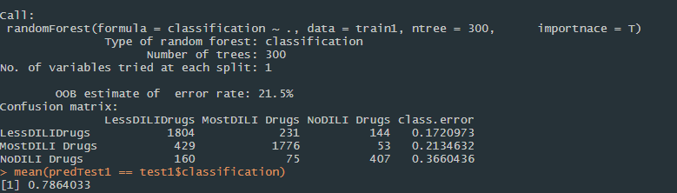
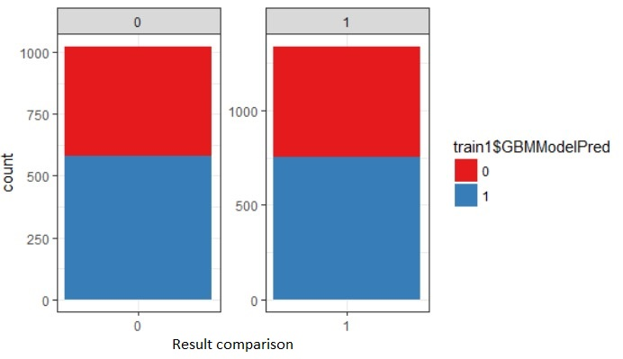
DATA MODELING
(Predictive Model : Dataset 1)
One-hot encoding to convert categorical features
Applied Random Forest on MostDili and others using test targets
Note:- ‘0’ represents LessDILI + NoDILI
‘1’ REPRESENTS MostDILI
Prediction: 98% on test data
(Predictive Model : Dataset 2)
Random Forest on test performance, test targets
Prediction: 78% on test Dataset

Slide 11
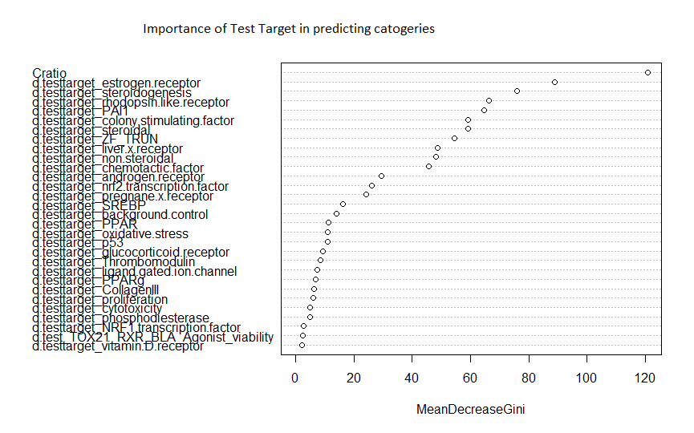
Important Features in Data

Slide 12
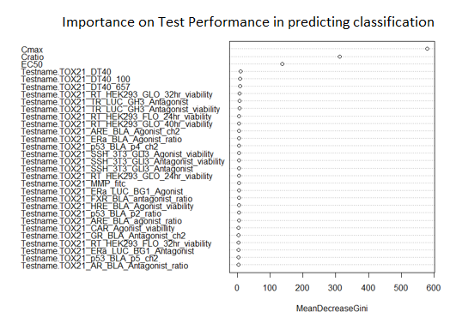
Important Features conti…

Slide 13
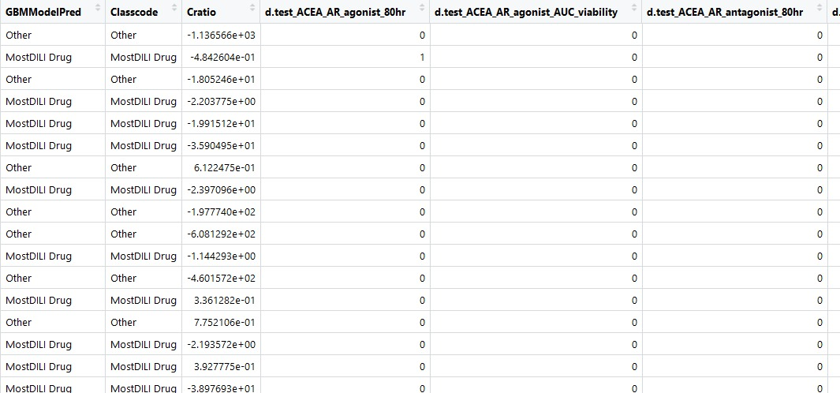
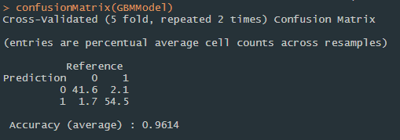
GRADIENT BOOSTING
Model doesn’t yield better result, instead it reduced the accuracy to 96%.

Slide 14
Conclusion
Following Model produces promising results that can be used for prediction but It would be better if we can cross validate it with external data rather then the dataset we cleaned our self.
We found that Cratio (derived from Cmax & AC50), ‘testtarget’ and the ‘test name’ have the highest dependency on predicting categories.
After Cratio, Estrogen receptor have higher accuracy of identifying the Toxicity in drug.

Slide 15
Scope of Improvement
We can perform text analysis using Allresults_flags.csv since the flag columns gives out descriptive information about the tests and is relatable in deciding the DILI category.
The problem is that Text classification can achieve very high accuracy rates possible (95%) but to achieve those you need to do a lot of text preprocessing before you run your machine learning models.

Slide 16
Future Scope
Faster Identification of harmful drugs
Saving money on research to perform tests on 100s of drugs before approval
Reducing the drug releasing time in Market

Slide 17
Thank You

